Slide 1

FINANCING SOLUTIONS FOR SOCIAL IMPACT

Slide 2
INTRODUCTION - WHAT WE DO
Our mission is to catalyse a new way of working to achieve enduring social and economic growth in the world. We do development differently, bringing together non-traditional partners at the convergence of results-based financing, impact investment, and blended public private partnerships – with the Sustainable Development Goals at the centre.
Results-Based Financing Mechanism
Design and Structuring
Compliance Support Services for the
Sustainable Development Goals
Capacity Building
Social Enterprise Investment Due
Diligence and Matchmaking Services
Impact Measurement Services

Slide 3
RESULTS-BASED FINANCING MECHANISM DESIGN AND STRUCTURING
Strat!gos supports development actors with the design of performance-based programs that base payment on achievement of pre-agreed metrics.
We are agnostic as to a preferred approach to these designs and base every solution on the context of the environment, the needs to the actors, and the risk appetite of these actors.
Common across all types of results-based financing mechanisms are the rigorous care paid to the development of the outcome metrics, sharing of risk, and transparency in achievement of the agreed targets.
Where private capital is deployed, extensive due diligence is needed on both the outcome metrics and the service provider partners to ensure a viable product.

Slide 4
WHEN GOOD INNOVATIONS GO BAD
A Rights-Based Approach to Land-Reliant Impact Investments

Slide 5
SO WHY IS THIS IMPORTANT?
In the last decade, impact investing is a concept that has spurred innovative financing mechanisms in emerging economies. Many believe that impact investing is one sure way pool private sector funds to help solve some of the most pressing challenges facing our world today.
In many economies that are land reliant, this is good news and we have seen impressive private sector dollars in sectors like agriculture and renewable energy. But it is not all good news.
Impact investing is generally defined as “Investments made into companies, organizations, and funds with the intention to generate social and environmental impact alongside a financial return

Slide 6
RISKS
Land Grabbing by intermediaries
Forced Evictions
No free, prior, and informed consent.
Certain safeguards should be put in place to ensure that community land rights are protected through out the lifecycle of a land-reliant impact investment - from the deal structuring stage through divestment.

Slide 7
LIMITATIONS OF THIS PAPER
As impact investing is a nascent field, a key limitation to the analyses of the subject matter of this paper is the unavailability of a sufficient sample size of relevant case studies. Further research on the subject matter should be an ongoing process as the number of land-reliant impact investments increase.

Slide 8
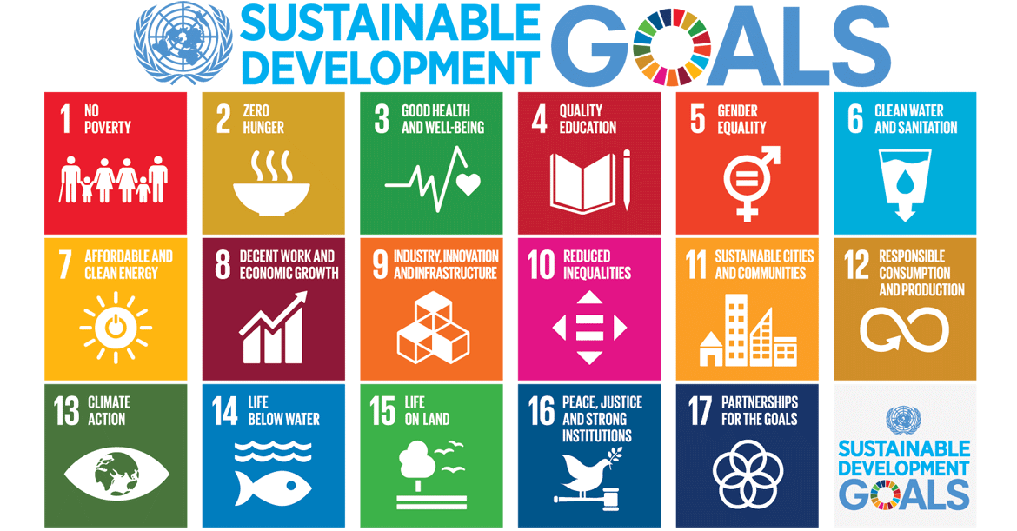
SUSTAINABLE DEVELOPMENT GOALS

Slide 9
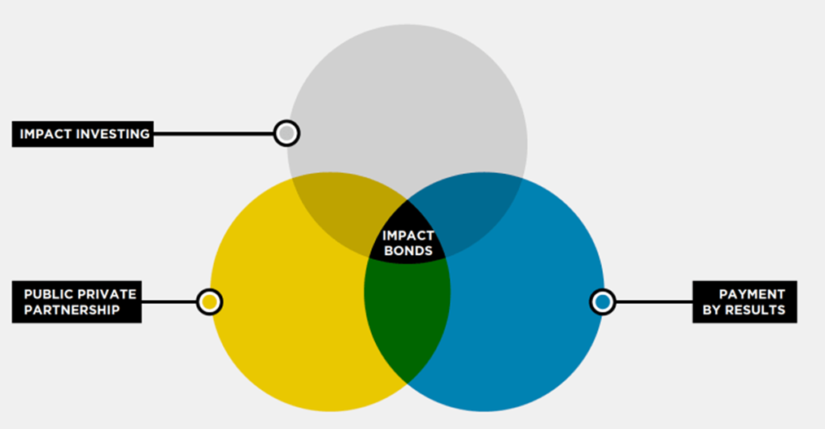
IMPACT INVESTING, THE STORY SO FAR

Slide 10
GROWTH
According to the Forum for Sustainable and Responsible Investment, from 2014-2016, in the US alone, sustainable and responsible impact investing grew by over 33% and at the 2017 World Economic Forum, UBS AG a Swiss global financial community, pledged to direct $5bn of all its clients’ investments over the next five years to sustainable or impact investments.

Slide 11
CASE STUDY – LAKE TURKANA WIND POWER PROJECT
About 2.5 billion people depend on lands and natural resources that are held, used or managed collectively. Africa is a significant target area for land acquisitions for large-scale agricultural projects and the continent accounts for 42% of concluded agricultural deals, closely followed by
Lake Turkana Wind Power Project (LTWP) is the single largest private investment in Kenya’s history. The wind farm covers 160 square kilometres (40,000 acres) and is located in Loiyangalani District, in Marsabit County, approximately 545 kilometres (339 mi), by road, north of Nairobi, Kenya's capital city
The wind farm been linked to competition for scarce resources, increased violence and failure to respect the land rights of the host communities.

Slide 12
CASE STUDY 2 MEXICO
Oaxaca Mexico
A community’s physical safety, drinking water, culture and livelihood was threatened by a hydroelectric project

Slide 13
POTENTIAL SAFE GUARDS
Principle 17 of the UN Guiding Principles on Business and Human Rights states: “In order to identify, prevent, mitigate and account for how they address their adverse human rights impacts, business enterprises should carry out human rights due diligence. The process should include assessing actual and potential human rights impacts, integrating and acting upon the findings, tracking responses, and communicating how impacts are addressed. Human rights due diligence.
The IFC's Draft Operating Principles for Impact Investing
Principle 5
Assess, address, monitor, and manage potential negative impacts of each investment.
Principle 4
Assess the expected impact of each investment, based on a systematic approach
  Implementing the impact bond and measuring impact.

Slide 14
Enterprises are urged to pay special attention to any potential human rights impacts that its business will have on individuals or groups that may be at heightened risk of vulnerability.
Investors should conduct proper human rights due diligence and communities should be mobilized from the outset and kept involved in all stages of the transaction.
The human rights risks identified, including social and environmental harms, should be evaluated and mitigated.

Slide 15
THE FUTURE - SUPPORTING LEGISLATION?
Host communities should be properly consulted utilizing international human rights standards and following the guidance set by the United Nations Guiding Principle Principles on Business and Human Rights and the IFC performance standards.
Investors should create a triple bottom line result strategy by aligning community interests with theirs and ensuring that there is no conflict.
The metrics used to measure successes of a project should also measure against community interests and benefits.
Prior to deployment of capital, investors should assist in policy advocacy to improve land tenure security.

Slide 16
Capital could be deployed in stages on the condition that host communities will continue to be actively engaged.
Project level risk analyses should also consider risks that are exacerbated by community tensions, for instance security risks and reputational risks.
Global multi-stakeholder initiatives should adopt standards tailored to ensuring that land-reliant impact investments are compliant with international human rights standards.
The impact investing community should standardize impact investments documentation to ensure that investments take into account risks posed to host communities.
Deal documentation for impact investments should mitigate potential risks to host communities and embed the outcomes that investors truly care about.

Slide 17
Land rights scholars and impact investment stakeholders should collaborate and share expertise so skill, experience and good intentions meet at an intersection that is truly beneficial to host communities.
Innovative Financing methodologies that seek to ensure communities have a stake in the financial returns should also be looked into – this is my favorite actually.
Impact investing is an innovation that sets to achieve responsible, mission-driven investments that have social, environmental, and financial returns. However, when these investments are land-reliant and fail to engage host communities throughout the lifecycle of a project—from deal structuring to divestment—the good intentions of these impact investments may have inherent blind spots that make them vulnerable to going bad.

Slide 18





WHO WE ARE (can we have it alphabetically?)
PETER VANDERWAL
CEO
GUILLAUME GEVREY
DIRECTOR
MOE ODELE
IMPACT INVESTING & SOCIAL ENTERPRISE LEAD
SHILPA SUBRAMANIAM
DIVERSITY & INCLUSION LEAD
AMÉLIE DUVERT
TEAM MANAGER

Slide 19

WHERE WE DO IT
Our multicultural and virtual team has presence and networks around the world

